Slide 1
RURAL DEVELOPMENT
TENANT CERTIFICATION
INCOME VERIFICATION
PROCESSING AND ERRORS
Presented by: LORI MERCER
JUNE 2018

Slide 2
Agenda Topics
Tenant Certification
  Timeframes
  Income
  Deductions
  Supporting Documentation & Verification
  Common Errors

Slide 3
Tenant Certification Requirements
All Tenant Certs are effective on the 1st of the month
  New Move-ins – if move in after the 1st, TC will be effective the 1st of the next month
All Tenant Certs must be transmitted by the 10th of the month in which it is effective
All households must be recertified at least annually
  If income changes by $100 or more per month – must recertify when change of income occurs
  If income changes of $50 or more per month, must recertify IF tenant requests
  If household size changes during the year, must recertify.

Slide 4
So, How Much is $100
$100 = $1200 annually or
  $46.15 if the tenant is paid bi-weekly.
  $23.08 if the tenant is paid weekly.
  $0.58 if the tenant is paid hourly.
  These figures are based on a full-time 40 hour work week.

Slide 5
Recertification Process
Two Notification Letters May Be Required
  1st – 75-90 days prior to effective date
  2nd – 30 days prior to effective date if no response from household
Note – a tenant certification can be transmitted via MINC at anytime during the 90 day period prior to the effective date

Slide 6
Expired/Late Tenant Certification
An Expired or Late certification is when it is not transmitted via MINC to RD by the 10th of the effective month
  If tenant does not provide required information to recertify
    Household is no longer eligible
    Household must pay Note Rate Rent
    Lease termination should be started
  If tenant provided information, and borrower is at fault
    Borrower must pay difference between the greater of the net tenant contribution or basic rent and the note rate rent (i.e. Basic Rent is $300, Tenant’s Rent is $325, Note Rent is $400, Borrower would pay $75)
    Example #2 – Basic Rent is $300, Tenant’s Rent is $200, Note Rent is $400, Borrower would pay $100
    Borrower must pay the overage amount from non-project funds until recertification is complete

Slide 7
WHAT IF THE TENANT DOESN’T QUALIFY TO LIVE AT THE COMPLEX?
Do not allow a tenant to sign a recertification if they no longer qualify based on income. A tenant eligible for occupancy in Agency financed housing must qualify as a very low, low or moderate-income household.
Do not allow a tenant to sign a recertification if they no longer qualify based on occupancy standards. Occupancy standards are established by the borrower and noted in the lease.

Slide 8
Keep At Your Fingertips
HB-2, Asset Management, Attachment 6-A, Annual Income Inclusions and Exclusions https://www.rd.usda.gov/files/3560-2chapter06.pdf
HUD Occupancy Handbook 4350.3, Exhibit 5-1: Income Inclusions and Exclusions https://portal.hud.gov/hudportal/documents/huddoc?id=DOC_35699.pdf
HB-2, Asset Management, Attachment 6-D, Family Assets https://www.rd.usda.gov/files/3560-2chapter06.pdf
HB-2, Exhibit 6-3, Acceptable Income Verification Sources https://www.rd.usda.gov/files/3560-2chapter06.pdf

Slide 9
Keep At Your Fingertips
HB-2, Asset Management, Attachment 6-C, Allowable Deductions (https://www.rd.usda.gov/files/3560-2chapter06.pdf)
HUD Occupancy HB, Exhibit 5-3, Medical Expenses That Are Deductible and Nondeductible https://portal.hud.gov/hudportal/documents/huddoc?id=DOC_35703.pdf
IRS Mileage Rates (irs.gov) Select Credit & Deductions, Select Individual Deductions (Standard Mileage) Medical/Moving.
HUD Income Limits (huduser.gov/) Select Data Sets, Select Income Limits
HB-2, Asset Management, Attachment 6-B, Zero Income Verification Checklist (https://www.rd.usda.gov/files/3560-2chapter06.pdf)

Slide 10
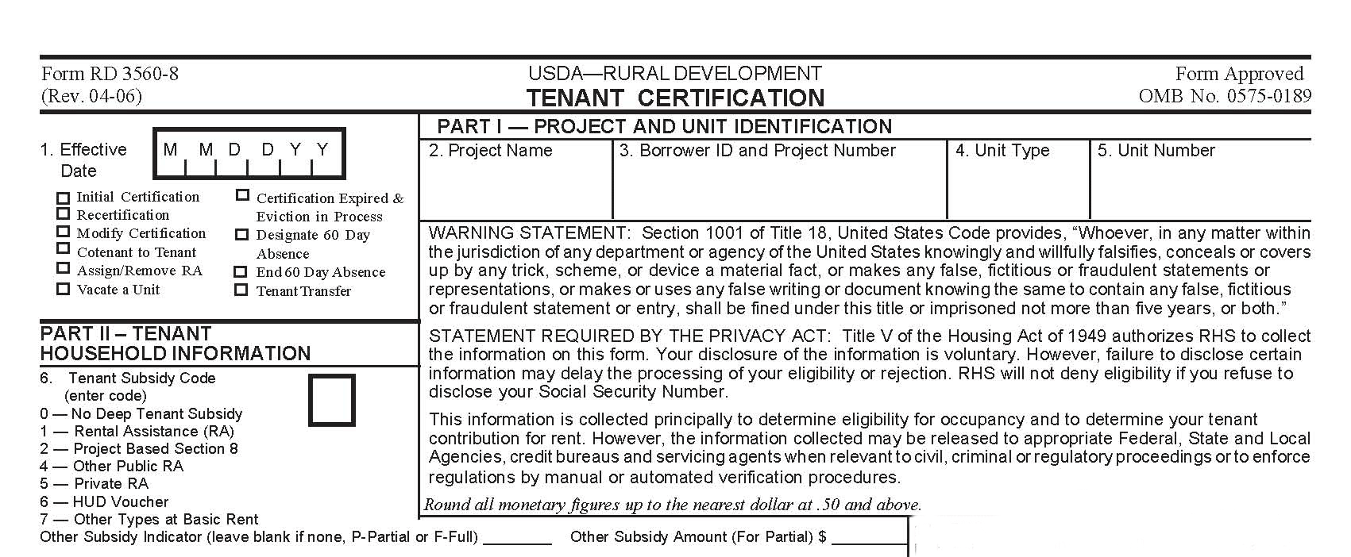
1. The effective date of an initial or updated tenant certification form will always be the first day of the month. If tenant’s move in date is after the 1st of the month the effective date will be the 1st of the next month.
Note: Check box indicating type of action
2-5.Make sure the following information matches the Project worksheet.
Enter appropriate code here based on subsidy received.

Slide 11
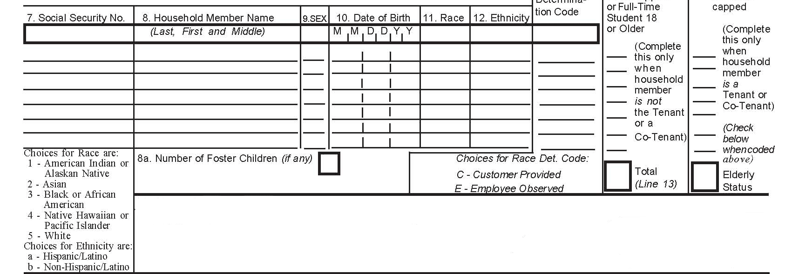
12a. Race Determination Code: How did you receive Race information. Enter appropriate code see codes below.
14. Enter appropriate code next to the tenant or cotenant if they are elderly (E) or disabled (D).
7-12. Social Security number, Name,
Sex, Date of Birth, Race, and ethnicity
of each person (s) living in complex.
For race and ethnicity codes see box in
Lower left hand corner.
Note: Foster children are not considered to be household members and are not to be entered as so.
Note: If any household member does not have a social security number but is eligible for housing, complete the field with all zeroes or use the alien registration number. MINC will assign a fictitious number. When transmitting the recertification, the assigned MINC number has to be used.
8a. Enter number of foster children who will reside in the unit.
13. Enter appropriate code next to the household member(s) indicating either Minor (M), Full-time student (F) or disabled (D).

Slide 12
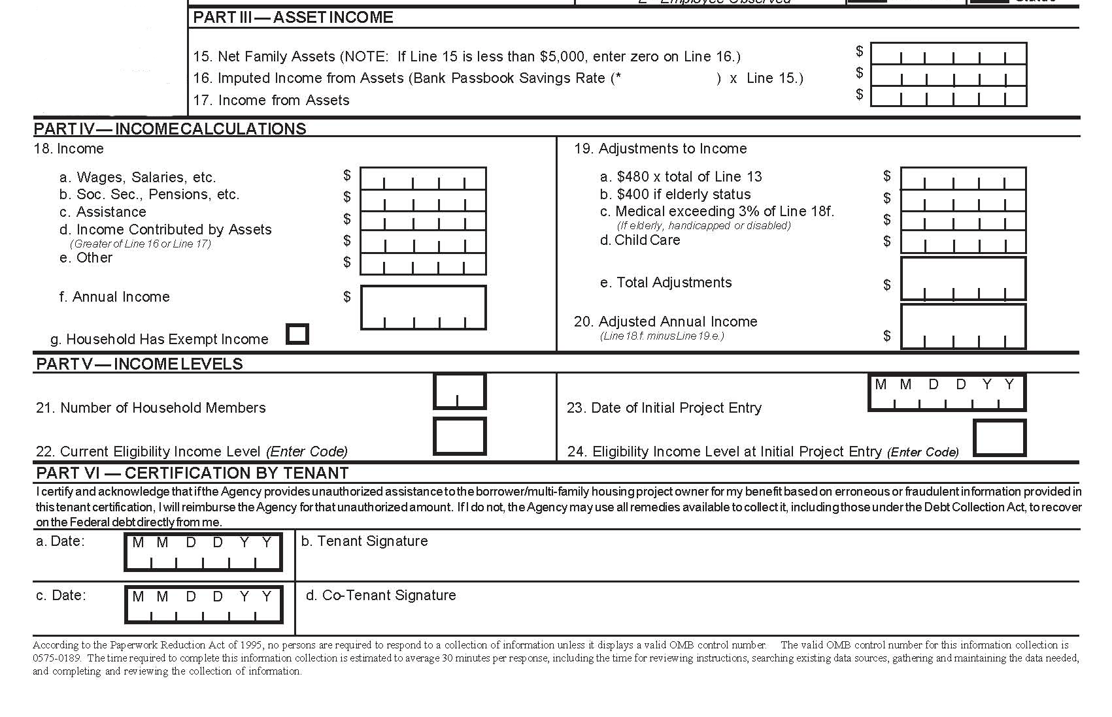
15. Enter all net family assets even if less than $5,000. (See Chapter 6, Attn. on what to include as a net family asset.)
17. Enter actual income received from assets. (See Chapter 6, Section 6.10 on calculating cash value of an asset.)
18a. Enter total annual income not monthly amount. And third party verifications must be obtained from the employer.
19a. $480 per minor or full-time student. See chap. 6 sec. 2 for details.
18b. Contact social security for percentage of annual increase.
16. Passbook savings rate is 2%.See chap. 6 sec. 2.
18a-f.
See
Chap. 6 attach. 6-A for what is considered income.
19a-d. See chap. 6 attach. 6-C for allowable deduction
19b.
$400 per elderly or disabled household
19c. If medical expenses are less than 3% of annual income (18f), enter zero. If expenses exceed the 3% rule enter only the amount over the 3%. (i.e.. Medical expense is 5,000, 3% of annual income is 2,000, you would enter 3,000)
18g. Rural Development will not accept a tenant certification with zero income unless all income is specifically exempted. See chap. 6 attach. 6-A for exempted income.
22 & 24. VL = Very Low, L = Low, M = Moderate and A = Above Moderate income. Per Adjusted Income Limits HB-1-3550, Appendix 9.
23. Date tenant physically moved into apartment.
Both Tenant and Co-tenant must sign and date.

Slide 13
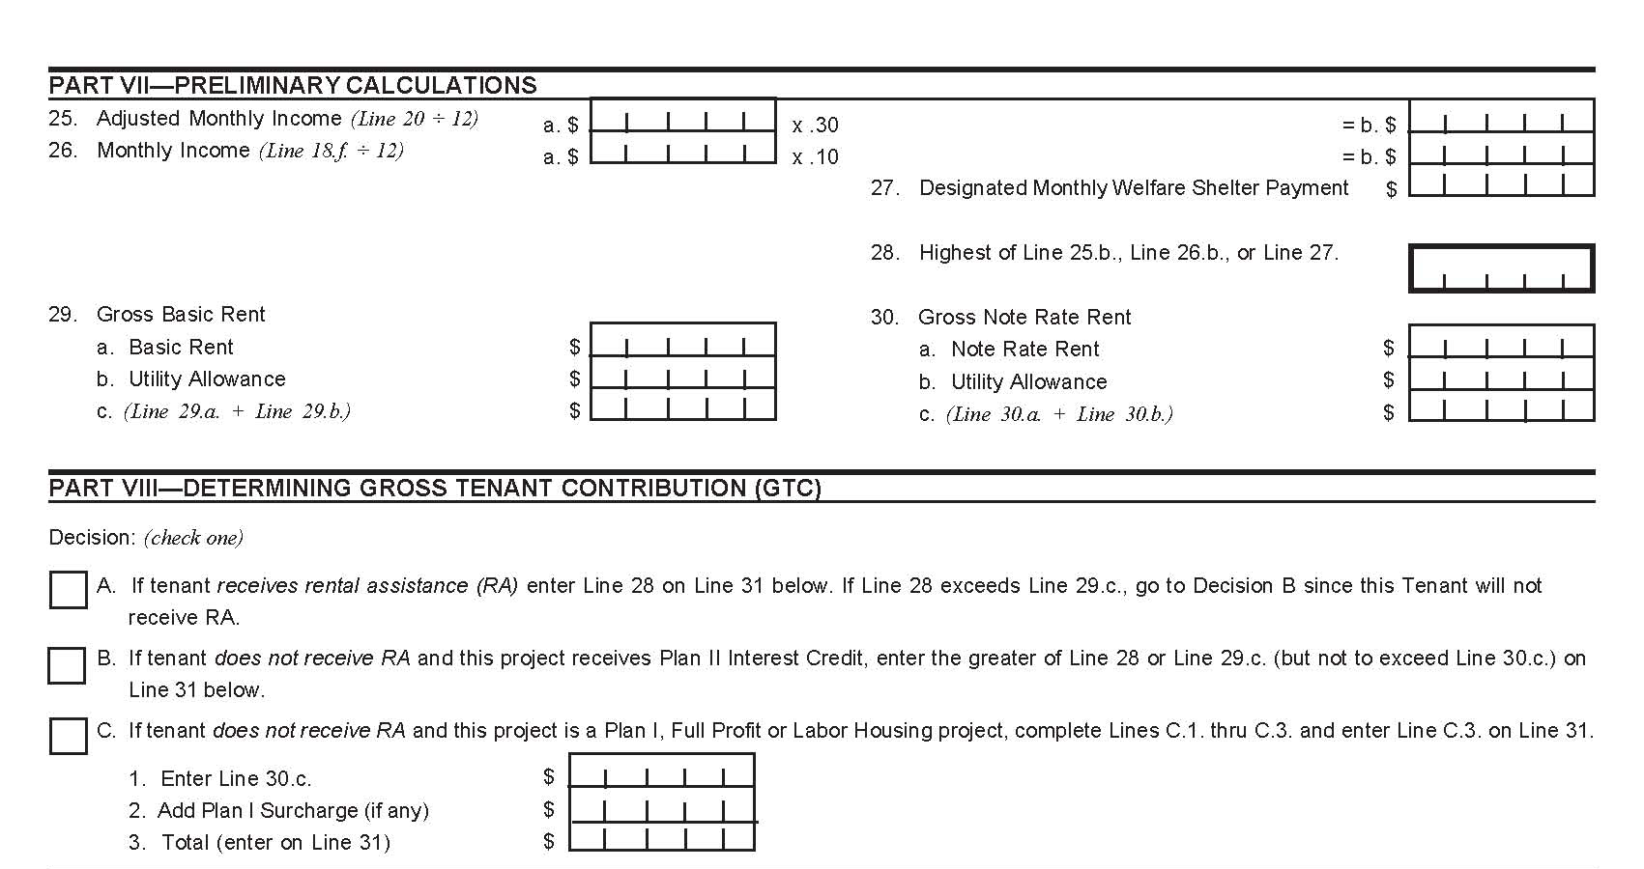
Note: Be sure to complete this section.
27. If this is applicable it will be the amount the tenant household actually receives from the Public Assistance Agency for shelter.
29. Enter approved basic rent from the project worksheet
28. Enter highest amount of line 25, 26 or 27.
Note: If utilities are included in rent enter zero.
Part VIII: Mark appropriate box

Slide 14
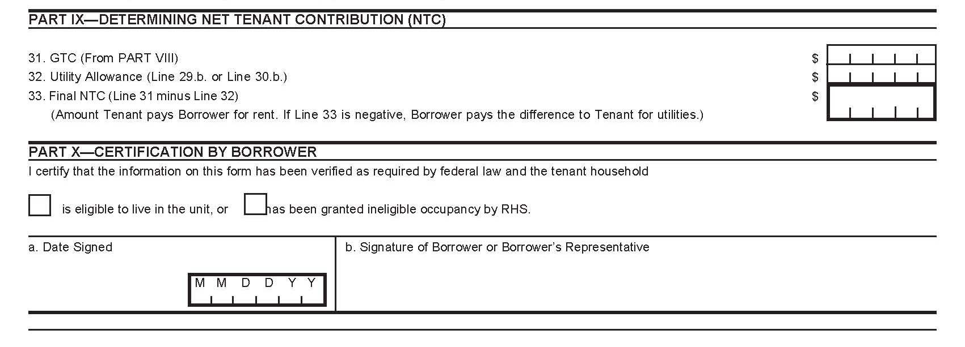
Note: Be sure to complete this section. Based on what boxed is marked in Part VIII.
32. From project worksheet
33. Line 31 minus line 32.
Note: A tenant or co-tenant has to be disabled or elderly to live in an elderly complex.
Note: If household is income ineligible, a wavier from the area office must be obtained.

Slide 15
The Work Number
Employer will not provide a VOE
Employer uses The Work Number
www.theworknumber.com
Employee can login to the site and get an instant report
Employee can call the Client Service Center to request a copy of the report 866-604-6570
Management companies may subscribe as an allowable project expense

Slide 16
“Top 10” Tenant Cert Boo-Boos!
10. Assets are not properly reported and/or imputed on the TC
9. Renting to Zero Income tenants or applicants
8. Using net SS income vs gross SS income
7. Miscalculating unusual income
6. Not annualizing income that is temporary/sporadic
5. Incorrect Standard Deductions (i.e. $400 vs. $480)
4. Incorrect calculations of medical expenses/disability expenses
3. Incorrect calculation of child support income and/or child care deductions
2. Tenant Cert not completed in it’s entirety or correctly
1. No supporting documentation in the tenant file of income/deductions

Slide 17
BOO-BOO #10 - Assets are not properly reported and/or imputed on the TC
Must consider at the time of initial certification and for all recertifications
Must be verified in writing by third party
  If unable to verify from 3rd party, can accept other forms of documentation (HB- 2, Section 6.10)
Verifications are valid for 90 days and may be valid for an additional 90 days with oral verification. Can be no longer than 180 days
Includes assets of all HH members
  Refer to HB-2 Attachment 6-D, Family Assets.
Document, document, document

Slide 18

Case Study #1 - Assets
Household has reported the following:
  $500 checking account
  $2,000 Savings Account earning 1% interest
  Life Insurance Policy with Face Value of $10,000
  Motor Boat valued at $10,000
  Prepaid funeral arrangements valued at $20,000
How much would you reflect on Lines 15 through 17 of the Tenant Cert Form?

Slide 19
Case Study #1 (Assets) – Answer
Line #15: $2,500 (checking and savings)
Line #16: -0- (assets less than $5,000)
Line #17: $20 (1% x $2,000)
  $20 will be carried forward to Part IV, 18 d.
Face Value of Insurance, Motor Boat and prepaid funeral expenses are exempted assets

Slide 20
Case Study #2 - Assets
Household has reported the following:
  $500 checking account
  $2,000 Savings Account earning 3% interest
  Life Insurance Policy with Cash Value of $10,000
  Prepaid funeral arrangements valued at $20,000
  $10,000 CD earning an interest rate of 4.5%; withdrawal penalty is $200 and taxes of $2,000
How much would you reflect on Lines 15 through 17 of the Tenant Cert Form?

Slide 21
Case Study #2 (Assets) – Answer
Line #15: $20,300 (checking, savings account, life insurance policy and CD)
  CD cash value is market value minus withdrawal penalty minus taxes ($10,000 - $200 - $2,000 = $7,800)
Line #16: $406 (2% x $20,300)
Line #17: $510 (4.5% x $10,000 CD; 3% x $2,000 savings account)
  $510 will be carried forward to Part IV, 18 d. since it is greater than the imputed income on line 16
Prepaid funeral expenses are exempted assets

Slide 22
Case Study #3 - Assets
Household has reported the following:
  $500 checking account
  $2,000 Savings Account earning 3% interest
  $20,000 CD earning an interest rate of 4.5%; withdrawal penalty is $200 and taxes of $2,000
  1 year ago a house valued at $60,000 was sold for $30,000; closing costs were $2,000
How much would you reflect on Lines 15 through 17 of the Tenant Cert Form?

Slide 23
Case Study #3 (Assets) – Answer
Line #15: $48,300 ($500 checking; $2,000 savings; $17,800 CD and $28,000 net value of home)
  CD cash value is market value minus withdrawal penalty minus taxes ($20,000 - $200 - $2,000 = $17,800)
  Count difference between the FMV (Fair Market Value) of asset and amount actually received:
    Example: FMV - $60,000
    Costs - ( 2,000)
    Sold - (30,000)
    Cash Value - $28,000
Line #16: $966 (2% x $48,300)
Line #17: $960 (4.5% x $20,000 CD $900; 3% x $2,000 savings $60)
  $966 will be carried forward to Part IV, 18 d. since it is greater than the actual income on Line #17

Slide 24
Case Study #4 – Assets
Household has reported the following:
  $500 checking account
  $2,000 Savings Account earning 3% interest
  $60,000 IRA earning an interest rate of 5%; withdrawal penalty $1,000; taxes $2,000
  2½ years ago, tenant sold a house for $40,000. It was valued at $60,000; unpaid loan balance $20,000; $6,000 was the expense of selling the property
How much would you reflect on Lines 15 through 17 of the Tenant Cert Form?

Slide 25
Case Study #4 (Assets) – Answer
Line #15: $59,500 ($500 checking; $2,000 savings and $57,000 IRA)
  IRA cash value is market value minus withdrawal penalty minus taxes ($60,000 - $1,000 - $2,000 = $57,000)
  Sale of house is not included as it was over 2 years ago
Line #16: $1,190 (2% x $59,500)
Line #17: $3,060 (5% x $60,000 IRA; 3% x $2,000)
  $3,060 will be carried forward to Part IV, 18 d. since it is greater than the imputed income on line 16

Slide 26

BOO-BOO #9 – Renting to Zero Income Tenants
Zero Income – RD’s policy is to not accept a tenant certification for an applicant or tenant with zero income unless all income is specifically exempted.
If applicant or tenant states they have no household income, they will need to demonstrate financial capability to meet essential living expenses.

Slide 27
BOO-BOO #9 –
Renting to Zero Income Tenants
The basis for this income must be documented in the file. Document, document, document
HB-2-3560, Attachment 6-B, Zero Income Verification Checklist can be used for this documentation.
The borrower MUST review the circumstances of the tenant quarterly.
  RD may wage match periodically
  Borrower can request wage match from RD at any time

Slide 28
Case Study #5 – Zero Income
Household has reported the following:
  The household reported that they have no employment, they are not receiving any government benefits and their income is -0-
  In conversation, the tenant mentioned that they receive $50 per month from parents to buy groceries
  Tenant owns a car and has a cell phone. According to the Zero Income worksheet, the tenant’s father pays for the car insurance every 6 months in the amount of $1,200 and the tenant pays for the upkeep and gas and their own cell phone
  Occasionally the grandmother gives clothes valued at $500 for the year to her grandchildren
  A local charitable organization has awarded a grant in the amount of $300 per month to assist with basic needs and utilities
  The Tenant also receives $150 per month by the management for picking up trash around the complex
What would be counted as income and what line would this be on the Tenant Certification?

Slide 29

Case Study #5 (Zero Income) - Answer
The following would be counted as income
  $50 per month since it is given in the form of cash ($50 x 12 = $600) – Line 18 e.
  The cost of the auto insurance - $2,400 – Line 18 e.
  $300 per month ($300 x 12 = $3,600) – Line 18 c.
  Total Income = $6,600
Exempted Income
  Clothing of $500 would be exempted since occasional
  Monthly Stipend since it is under $200

Slide 30

BOO-BOO # 8 Using Net SS vs. Gross SS Income
For income, always use the Gross Income
Usually, in October it will be announced if SS will be increasing for the following year
  Be sure to factor in this increase (could be 2 months at 2018 rate (Nov. & Dec. and 10 months at 2019 rate)
Be sure to factor any adjustments for prior overpayment of SS benefits

Slide 31
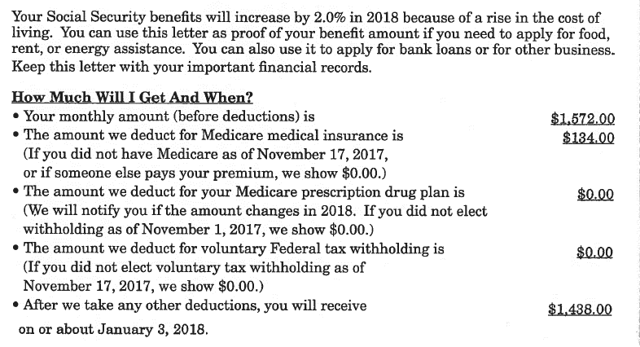
Case Study #6 - SS
Tenant is receiving SS Benefits as shown below. Because there was an overpayment, the SS amount below is being reduced by $80 for 6 mos.
What would be their SS Income on line 18b.?

Slide 32

Case Study #6 – (SS) - Answer
$1,492 ($1,572 - $80) x 6 mos. $8,952
$1,572 x 6 mos. = $9,432
Total SS Income $18,384

Slide 33
BOO-BOO #7
Miscalculating Unusual Income
Income from a Business
Unemployment
Withdrawal from IRAs or 401k Accounts

Slide 34

Income from a Business
Must count Net Income
  Net Income is Gross Income less expenses
  If net income is a negative number, must use “0”
  Must request most current tax return
  Compare figures tenant provided with tax return

Slide 35
Case Study #7 – Business
Household has Lawn Care Service/Snow Removal Business
HH is reporting a negative loss of ($2,754)
According to previous year’s tax return, the gross income was $20,000, the expenses and depreciation were $10,000, a net income was realized of $10,000
Recertification Period is October 1
What would be counted as business income and where would you reflect it on the TC?

Slide 36

Case Study #7 – (Business) - Answer
Based on tax return, the answer would be $10,000
  Since 10 months have passed, tenant could provide additional documentation to support the negative figure of $2,754
    If accept new documentation, the answer would be “0”
Business Income would be reflected on Line 18 e.

Slide 37
Annualizing Unemployment
Unemployment is counted as income
If household is receiving unemployment, must figure unemployment for entire 12 months even if verification reflects that unemployment is not available for the full year
Would recertify at the end of the unemployment period if need be

Slide 38
Case Study #8 – Unemployment
Household is receiving unemployment benefits for 12 weeks for $125
What would their income be and what line would this be reflected on?

Slide 39
Case Study #8 – (Unemployment) - Answer
52 weeks x $125 = $6,500
Need to recertify at the end of the 12 weeks since income will change
Unemployment can be reflected on either 18 a. or 18c.

Slide 40
Withdrawals from IRAs and 401k Accounts
The full amount of periodic payments from IRAs, Pensions, Insurance Policies, Retirement Funds, etc. is counted as income
  Withdrawals from IRAs and Retirements funds that are not routine would not count as income
Still need 3rd party verification
  Yearend statements of Mutual Funds or 401k accounts can provide information about routine annual income

Slide 41
Case Study #9 – 401k
Tenant has a 401k account and receives $400 per month
Tenant is also cashing in one of their IRAs valued at $2,000 for a vacation
What would be counted as income and what line would this be reflected on the TC?

Slide 42

Case Study #9 - (401k) - Answer
$400 per month is considered routine income and would be counted as income ($400 x 12 = $4,800)
  Yearend statement of 401k should reflect this
  Depending on how this 401k is established, it may or may not be counted as an asset – could have imputed income if it is an asset
The IRA of $2,000 would not be counted as income as it is not routine
  However there could be some imputed income from the IRA since it is an asset
This should be reflected on Line 18 b.

Slide 43
BOO-BOO #6 Not Annualizing Income that is Seasonal / Sporadic
Some employment is not year round
  Must estimate what the income will be for the year
Must verify income
  If seasonal, may have to request more than 1 year’s history of employment
    If worked 3 years, obtain all 3 years and average
    If new, have employer project hours to be worked the next 12 months based on their knowledge of past work history

Slide 44
Case Study #10 – Annualizing Income
Tenant is a construction worker in which the work is seasonal
  He works for a company (not self-employed)
He is paid $15 per hour when working
  Tenant stated that he works 40 hours per week for 6 months out of the year
  Employer stated that he worked 40 hours per week for 6 months in 2014, 7 months in 2015 and 8 months in 2016
How much would you reflect on Line 18a as salary?

Slide 45
Case Study #10
(Annualizing Income) - Answer
Since tenant has worked 3 years:
  Average the total hours for all 3 years
    2014 – 1040 hours (26 weeks x 40 hours)
    2015 – 1213 hours (30.33 weeks x 40 hours)
    2016 – 1386 hours (34.66 weeks x 40 hours)
    Total Hours = 3,639 / 3 years = 1213 hours x $15 = $18,195 would be the income reflected in 18a

Slide 46
BOO-BOO #5
Incorrect Standard Deductions
$480 deduction for each family member (not a tenant or co-tenant)
  Under 18 years of age;
    Does not include unborn child
    If joint custody, both parents cannot claim the deduction for the child if both parents live in subsidized housing
      If dispute which family gets to claim the deduction, must refer to any legal documents or IRS returns and deduction is claimed by the parent shown receiving the IRS deduction or identified in legal documents
  A person with disabilities who is over 18 and not the tenant or co-tenant;
  A full-time student of any age;
    Must have documentation from school
    Must still be living in household
  Foster children are not eligible for the standard $480 deduction

Slide 47
BOO-BOO #5
Incorrect Standard Deductions
$400 deduction for elderly or disabled
  Must be the tenant or co-tenant
  Only one deduction for the household, i.e. both tenant and co-tenant are over age 62, but only 1 $400 deduction can be taken
  Must be 62 years of age or have a disability at any age
  Must have documentation to support $400 deduction

Slide 48
Case Study #11 – Deduction
Tenant & Co-Tenant are not elderly or disabled
There are 3 children and one on the way, ages 10, 18 & 19
  18 year old is a full-time student, 19 year old is working but not a student
The co-tenant’s 64 year old disabled mother is living with them
What deductions are this family eligible for?

Slide 49
Case Study #11 – (Deduction) -Answer
$480 deduction for 2 children (Ages 10 & 18)
  18 year old is a full time student
  No deduction for unborn child
  No deduction for 19 year old since over age and not a full-time student
    Note – would need to count the income of the 19 year old
$480 for the disabled mother
  Must have documentation of disability
  No elderly deduction because mother is not the tenant or co-tenant
Total Deduction = $1,440

Slide 50
Case Study #12 - Deduction
Tenant is 35, Co-Tenant is 30 and disabled
Tenant has a child who is 4 and is sharing joint custody with his ex-wife who also lives in another RD complex. The child lives with the ex-wife during the week, but with the tenant every weekend and 6 weeks through the summer
  The tenant (father) claims the child on his tax return
What deductions is this eligible for?

Slide 51
Case Study #12 – (Deduction) - Answer
$400 because the co-tenant is disabled
  Documentation must be provided of disability
$480 deduction for the 4 year old child
  Even though the child spends more time with the mother, the tenant (father) provided a copy of the divorce decree and tax return which allows him to claim the child as a dependent. The mother could not claim a deduction for the child at the other RD complex.

Slide 52
BOO-BOO #4 – Incorrect Calculations of Medical Expenses/Disability Expenses
Medical expenses can be deducted for elderly/disabled household
  If household qualifies for $400 deduction, then the medical expenses for the entire household can be claimed
  Expense to be claimed is what is anticipated for next 12 months based on past history
  Can allow for past medical event that is not likely to recur (i.e. unplanned surgery, injuries from car accident, etc.) if not claimed previously

Slide 53
BOO-BOO #4 – Incorrect Calculations of Medical Expenses/Disability Expenses
Reimbursed medical expenses from insurance cannot be claimed
The amount of medical expenses that can be claimed as a deduction is anything over 3% of annual income (not adjusted)
Must have documentation of medical expenses
  Over the counter (OTC) medical expenses must be prescribed by licensed practitioner in order to claim deduction
  Must have copies of receipts and prescriptions for OTC expenses

Slide 54
Case Study #13 – Medical Expenses
Elderly Household had SS Income of $600 per mo.
  Tenant Cert is effective 1/1/2017
  Medicare premium is $100 per mo.
  Supplemental Health Ins. Policy is $200 per mo.
  Pharmacy prescriptions reflect $2,000 in 2016
    Tenant is still taking the same prescriptions
  Hospital Bill owed of $500 in which tenant is paying $100 per mo.
  OTC receipts reflect $200 (Aspirin, Pepto Bismol, Ben Gay, Band-Aids, etc.)
  Hearing Aid purchased in 2016 for $2,000 and Batteries of $100
    Supplemental insurance paid $1,500 for the hearing aid
What would the Medical Expense Deduction be?

Slide 55
Case Study #13 – (Medical Expenses) - Answer
Allowable Medical Deductions -
  $1,200 for Medicare ($100 x 12)
  $2,400 for Supplemental Health Ins. ($200 x 12)
  $2,000 Prescription Medicine
  $500 payment on hospital bill
  $600 for hearing aid and batteries
    Allowed $500 for hearing aid since this was not claimed in 2016 and was not reimbursed by insurance
Not allowed - $1,700
  OTC Medicine since no prescriptions - $200
  Hearing Aid reimbursed by ins. - $1,500
Total medical expenses anticipated are $6,700
Total Medical Deduction allowed - $6,484
  3% x $7,200 (Line 18 f. which is $600 month x 12) = $216
  $6,700 – 216 = $6,484

Slide 56
Disability Assistance Expense
Deduction for unreimbursed, anticipated costs for attendant care and “auxiliary apparatus” for each disabled family member
  HH does not have to qualify as an elderly household
Qualification for Deduction
  Must enable a family member 18 years of age or older (who may or may not be the disabled member) to be employed
  If more than one family member enabled to work, must consider the combined incomes of those persons
  Must have documentation of disability and need for animal/apparatus, etc.
Allowable deduction is any cost over and above 3% of annual income (not adjusted)
  Cannot exceed the earned income received by the family member(s) who are enabled to work

Slide 57

Case Study #14 – Disability Expenses
Tenant and co-tenant are both 40 years old and have a 15 year old son who is disabled. It is determined the son would be allowed a seeing eye dog.
Tenant is away from the family for a short stint in the military and earns $10,000 per year; co-tenant stays at home with the son but has found a job and will earn $6,000 per year
It is determined that the cost of the seeing eye dog is $5,000, $2,000 of which is covered by a special grant from a service organization. Vet costs per year will be $1,500, food for the year will be $2,000 and supplies will be $500
What would the Disability Assistance Deduction be?

Slide 58
Case Study #14 – (Disability Expenses) - Answer
Allowable Disability Assistance Expenses
  $3,000 for the seeing eye dog ($5,000 - $2,000 grant)
  $1,500 for vet visits
  $2,000 for food
  $500 for supplies
  Total anticipated disability assistance expenses $7,000
Household’s annual income of $16,000 x 3% = $480
  Co-tenant is the one enabled to work and has an annual income but you use total household income to calculate 3% allowance
Total available to claim would be $7,000 - $480 = $6,520
Total amount allowed for disability assistance expense is $6,000
  Amount of co-tenant’s annual salary

Slide 59
Disability Assistance Expense
For Elderly HH that is eligible for BOTH medical and the disability deduction, it must be calculated separately
  Must calculate disability assistance first
    Reminder – it cannot exceed the income of the person(s) that has been enabled to work
  Then calculate allowable medical expenses
    When family has both disability and medical expenses, review both to make sure no expense has been inadvertently included in both categories
  Add Medical and Disability Assistance expenses and deduct from 3% of household annual income

Slide 60
Case Study #15 – Medical and Disability Expenses
Elderly Household – Co-tenant is disabled
Co-tenant needs a live-in aide in order to allow Tenant to work
Tenant’s income is $20,000
Live-in Aide expense is $10,000 and the aide has other income of $5,000
Co-Tenant also needed auxiliary equipment (wheelchair) costing $5,000
They also have non-reimbursed medical expenses of $3,000
What would the Disability Assistance and Medical Deduction be?

Slide 61
Case Study #15 – (Medical and Disability Expenses - Answer
Disability Expense $15,000
  Live-in Aide was $10,000
  Auxiliary Equipment was $5,000
Medical Expense $3,000
Total Disability and Medical Expense $18,000
Less 3% of HH Annual Income - $600
  $20,000 x 3%
Total Allowable Deduction $17,400
Note – the Live-in Aides’ other income of $5,000 is excluded as it is not counted toward the household’s income

Slide 62
BOO-BOO #3 Incorrect Calculation of Child Support Income and/or Child Care Expenses
Child Support Income:
  Household must include all alimony or child support payments
    Must have verification (court orders, statements from enforcement agencies, divorce decree, or other records to support payment)
    The applicant/tenant must report what was paid in the last 12 months
    If not receiving child support payments, the applicant/tenant must show that they have requested assistance from the state or local entity responsible for enforcement of payment
  Note: If tenant/co-tenant is paying child support – this is not an allowable deduction even if this is being garnished from their salary

Slide 63
Case Study #16 – Child Support
Tenant has 2 children and is to receive child support payments of $500 per month
  Divorce Decree supports this amount
Tenant states she is not receiving these payments and provides a copy of last month’s bank statement which reflects that no child support was deposited
What would you count as income for the Child Support and what line would it be on the TC?

Slide 64

Case Study #16 – (Child Support) -Answer
Child Support Income is: $6,000
  Applicant/Tenant did not provide evidence of what was received for the last 12 months; and
  Applicant/Tenant had not pursued collection through State Agency or legal action
  If documentation is provided then you could report whatever is presented as income
Reflect on Line 18 e.

Slide 65
Child Care Expenses
Reasonable child care expenses for the care of a child age 12 or under may be deducted from “annual (gross) income” if they:
  Enable an adult family member to actively seek employment, be gainfully employed, or further his/her education; and
  If the expenses are not reimbursed; and
  If they have demonstrated that there are no other adult household members available for child care

Slide 66
Child Care Deduction
The amount may not exceed the amount of income received from employment.
The amount cannot be paid to a household member
The amount of child care hours must parallel the hours household member works or goes to school including travel time.
The applicant must identify the household member who can go to work or school as a result of the child care.
The tenant file must contain justifying documentation to support the deduction.

Slide 67
Case Study #17 – Child Care
Tenant earns $18,000 & Co-Tenant works part-time 4 hours per day/5 days a week and earns $4,000 and attends school part-time 4 hours per day/5 days a week
The Tenant identified that the Co-Tenant would be able to work and go to school if child care was provided
They have 2 children ages 13 & 11 and they pay $5 per hour for 8 hours/5 days a week for each child.
What would the Child Care Deduction be and what line would it be on the TC?

Slide 68
Case Study #17 – (Child Care) - Answer
Child care expense for the time the co-tenant is working is $4,000
  $5 x 4 hours = $20 per day x 5 days = $100 per week x 52 weeks = $5,200
  Can only claim $4,000 since income of co-tenant is less than child care expense
  Cannot claim the expense for the 13 year old
Child care expense for co-tenant while going to school is $5,200
  $5 x 4 hours = $20 per day x 5 days = $100 per week x 52 weeks = $5,200
  Child care cost is not limited while attending school
Total allowable Child Care Deduction is $9,200 ($4,000 + $5,200) and would be reflected on Line 19d of Tenant certification

Slide 69
BOO-BOO #2 – Tenant Certification is not Completed in it’s Entirety or Correctly
Part I, Item 1., Action type is not correctly identified
  i.e. Tenant moves out, and co-tenant becomes tenant, must mark Co-Tenant to Tenant Box
  Must recertify because household composition changed
Part II, 6. Tenant Subsidy Code is not completed correctly
  If getting State RA, Code #4
  Don’t use Code #5, it is not working correctly at this time
  Code #7 if other types of subsidy at basic rent (i.e. church is paying subsidy)
Part II 7. – Social Security Numbers
  All households members are required to have a SS #
    Tenants will need to provide a SS# for all household members over the age of 6.

Slide 70
BOO-BOO #2 – Tenant Certification is not Completed in it’s Entirety or Correctly
Part II, 14. – Coding for Disabled (“D”) and Elderly (“E”)
  Insert a “E” or “D” by only the Tenant and Co-Tenant – be sure to mark Elderly Status box if any of the above applies
Part IV, Item 18 g. – if household has reported “zero” income, and the income is exempted, then this box must be marked.
Part V, Item 23, be sure to show the actual date of move-in (does not have to be the 1st of month)
Part V, Item 24, reflect income level at the time of move-in. This should not be changed on subsequent recertifications

Slide 71
BOO-BOO #2 – Tenant Certification is not Completed in it’s Entirety or Correctly
Part VII, Item 29 a. and 30 a, Basic Rent & Note Rate Rent – be sure rent is the same as the current approved budget
  If project worksheet does not agree with budget, notify servicing office immediately.
Part VII, Item 29 b. & 30 b., Utility Allowance
  If utility costs are included in rent, enter “0”
  Utility Allowance must agree with approved budget. If it does not agree, notify servicing office immediately.

Slide 72
BOO-BOO #2 – Tenant Certification is not Completed in it’s Entirety or Correctly
Part X, Certification by Borrower
  Be sure to indicate if household is eligible
    This includes income eligible and occupancy eligible
  If not eligible, must obtain waiver or approval from servicing office prior to renting to household
Part VI & X, Tenant/Co-Tenant and Borrower Signatures
  Even though tenant certification is transmitted, this form must still be signed by all parties and a copy provided to the tenant.
  Signed tenant certification must be retained in the Tenant File

Slide 73

BOO-BOO #1 - No Supporting Documentation of Income, Deductions, Disability, etc.
Verify and Document
Verify and Document
Verify and Document
Verify and Document
Verify and Document

Slide 74
OPEN TIME FOR ADDITIONAL QUESTIONS!!!!
THANK YOU, THANK YOU, THANK YOU
FROM
RD – MFH STAFF

